Slide 1
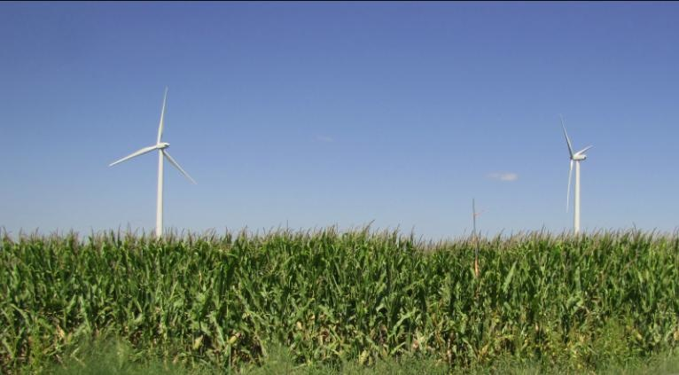
Wind Turbine Wake Investigation from Surface Measurements during the 2010 and 2011 Crop Wind-energy EXperiments (CWEX-10/11)
D. A. Rajewski¹
E S Takle^{1,2,}, T. W. Horst³, S. P. Oncley³,, J. K. Lundquist⁴, M. E. Rhodes⁵, J H Prueger⁶, R. Pfieffer⁶, J Hatfield⁶ , R. K. Doorenbos², and K. K. Spoth²
Dan Rajewski
(drajewsk@iastate.edu)
¹Geological & Atmospheric Sciences, ²Agronomy
Iowa State University, Ames, IA
³National Center for Atmospheric Research ⁴Atmospheric and Oceanic Sciences, ⁵Aerospace Engineering Sciences University of Colorado, Boulder, CO
⁶ National Laboratory for Agriculture and the Environment, Ames, IA

Slide 2
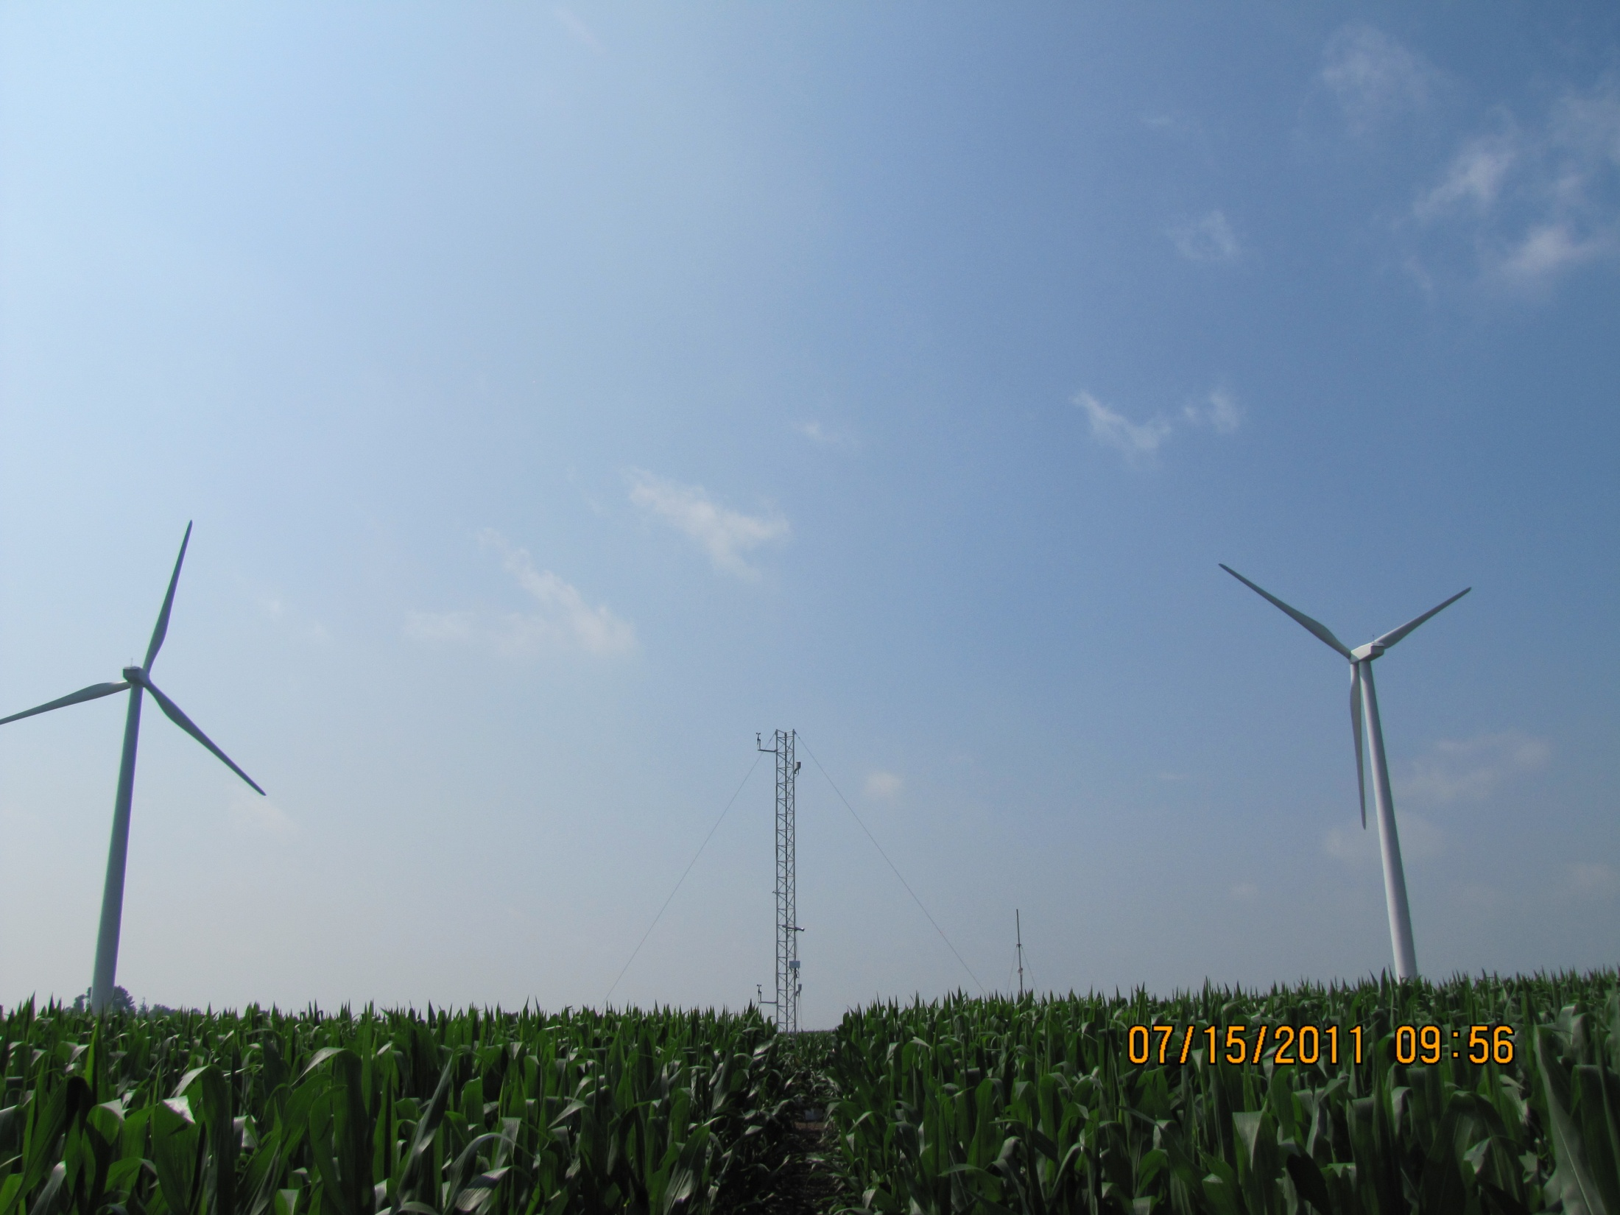
Objective: Examine leeward aerodynamics of a line of turbines by use of surface and LiDAR measurements
Photo by: Russell Doorenbos

Slide 3
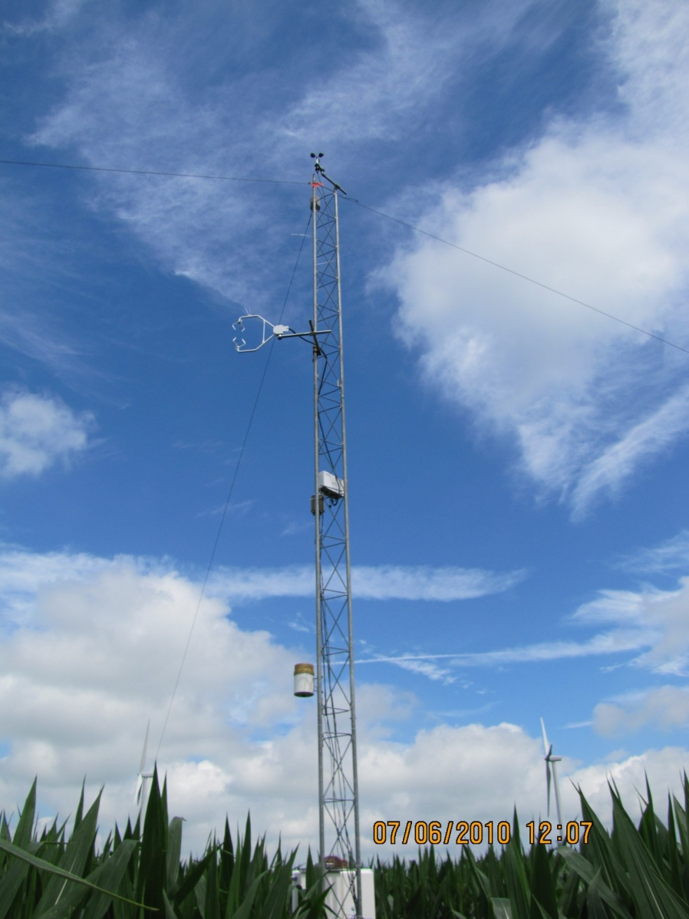
Other CWEX objectives
Measure change in fluxes produced by turbines in a wind farm co-located with intensively managed agriculture
Multi-use, high-land-value environment
Crops are tuned to climate conditions
Do turbines influence the microclimate for crops?
Develop a test bed for validating high-resolution models of wind-farm performance and coupling to surface and PBL
General understanding of impacts of turbines
Understand turbine-turbine interaction and wind-farm performance
Options for further wind farm build-out: Go higher? More dense?
Iowa has a flat terrain, strong LLJ, not unlike coastal jets, many existing windfarms and component manufacturers: zero-order test bed for off-shore
Develop a deeper understanding of how the PBL interacts with a wind farm
How momentum replenished from above as air flows through the wind farm?
How does the wind farm change mesoscale flow fields and possibly rearrange convection in the PBL?
Photo by:
Russell Doorenbos

Slide 4
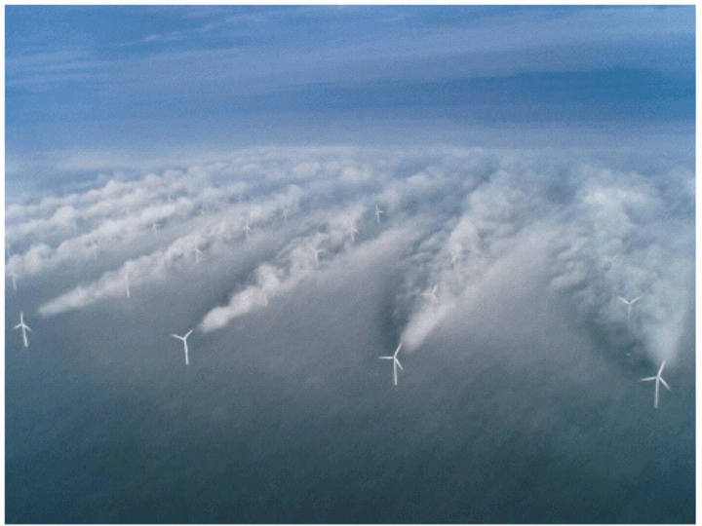
CWEX Motivation:
Heterogeneities of wind turbine wakes
offshore of Denmark
wake ‘sheet’ from several lines of merging wakes
Diffuse patches of wakes from multiple lines of turbines
‘double wake’
‘far wake’
‘near wake’
L
H
Wake structure differences appear in 2nd line of turbines
Pressure fields and moist ocean surface responsible
for this ‘turbine fog’ Emeis (2010)
On-shore wake detection is plausible from SAR-guided
measurements (Christiansen and Hasager 2005)
Source: UniFly A/S
Horns Rev 1 owned by Vattenfall. Photographer Christian Steiness.

Slide 5
1995)
Conceptual model of Turbine-crop Interaction via mean wind, perturbation pressure, and turbulence fields, adapted from Wang and Takle (1995)
over-speeding zone
turbine wake
H
L
wind-ward
reduction zone
‘near wake’
day
H₂O
night
‘far wake’
H
L
CO₂
Heat
……..................
night
……...........................................................................................................................
leeward ‘bleed’ through
and speed up-zone
day
Site 1
Site 3
Site 1
Site 2

Slide 6
CWEX-10/11 Analysis procedure
Calculate 10-minute flux and LiDAR differences (‘Downwind’- ‘Upwind’ reference) for all stations north of the turbines
Key variables in CWEX-10: U/U₀ , TKE/TKE₀ ; CWEX-11: U/U_{0(H)} , (σ_{u}²+σ_{v}²)/U_{0(H)}, w, wind direction
Use 5-degree wake expansion factor (e.g. Barthelmie et al. 2009) to determine ‘waked’ wind directions for the nearest mast north of the turbine line
CWEX-10 (NLAE 2) [example in next slide]
CWEX-11 (WC 49)
Isolate poor data quality periods (e.g. precipitation, tower maintenance)
Separate ON vs. OFF periods of turbine operation from SCADA wind speed for nearest turbine to NLAE 2 in CWEX-10 and use upwind LiDAR (WC 68) for CWEX-11
Remove CWEX-11 data during the wind-cube inter-comparison period (June 30-July 2)
Organize data by direction and stability categories
(NEUTRAL, STABLE, UNSTABLE using z/L₀ classification as in Rajewski et al 2012, in press)

Slide 7
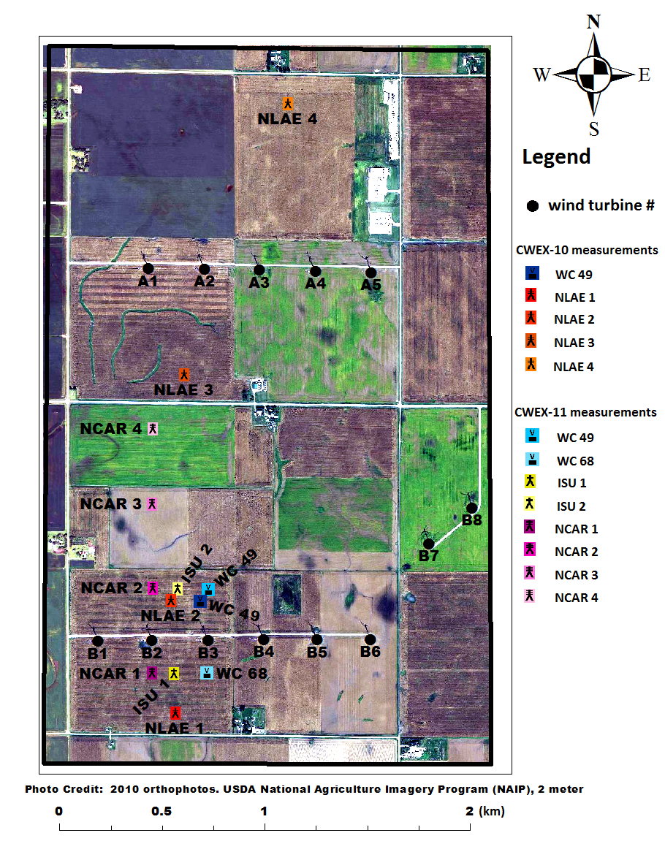
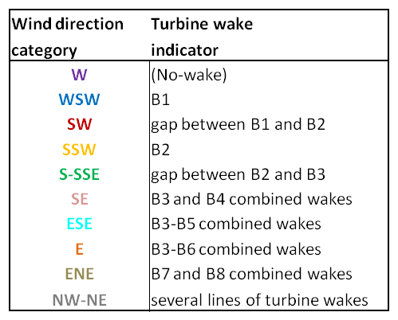
Waked wind direction categories
Example for NLAE 2 flux tower
NW-NE
ENE
W
E
WSW
ESE
SW
SE
S-SSE
SSW

Slide 8
Factors influencing turbine wakes
Upwind 80-m wind direction
(centerline vs. periphery effects important to distinguish with downwind distance)
Upwind 80-m wind speed
(wind speed determines the amount of power generation and wake-turbulence production)
reference cut-in at 3.5 m/s, but nacelle speed can be > 1.7 m/s to generate power
Greatest wake influence when reference speed is between cut-in and rated (13 m/s)
Thermal gradient/vertical shear
(ambient vertical directional shear > 30° disorganizes the wake)
These factors have stronger influence on wind farm performance during nighttime (STABLE) conditions

Slide 9
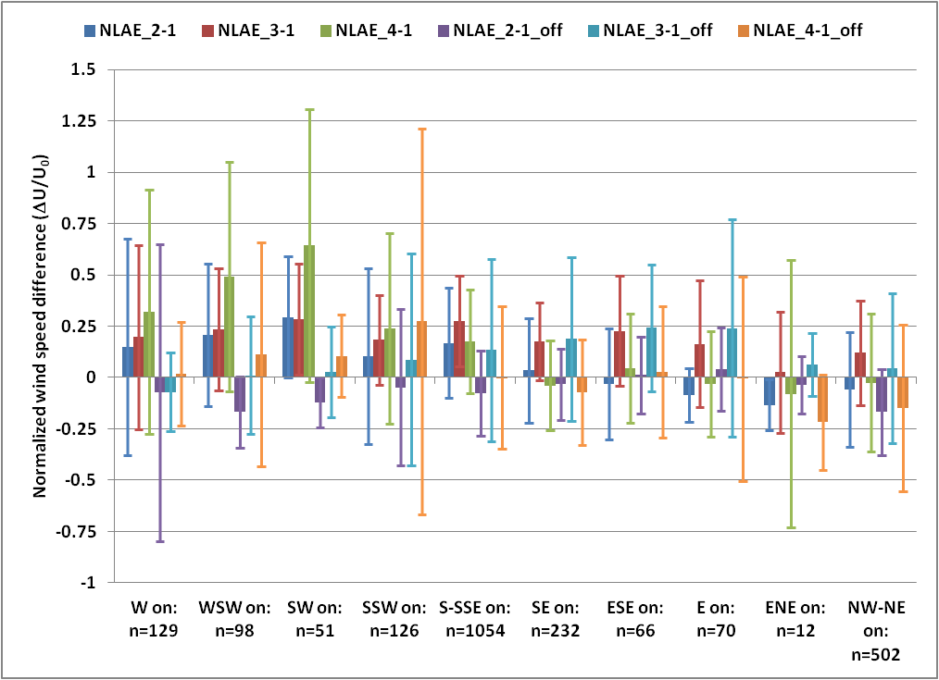
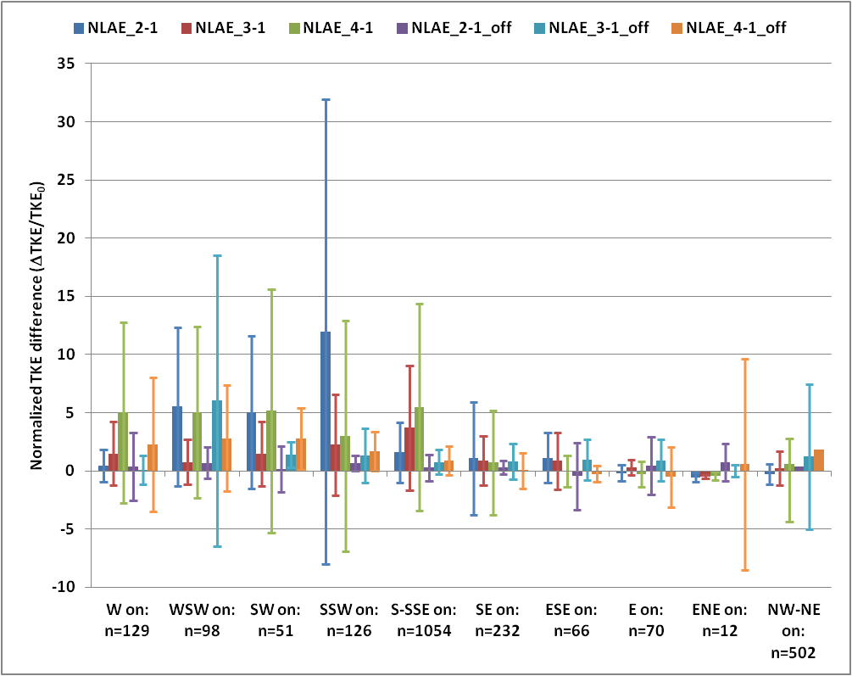
CWEX-10 wake summary (STABLE)
[Pressure field influence
in near-wake?]
[wake reaching the surface
in the far wake/double wake
locations?]
Normalized speed (ΔU/U₀)
Uniformly enhanced TKE
at 5-10 D downstream from
two merged wakes?
(ΔTKE/TKE₀)
Surface TKE largest at near-wake
location (2-3D) for SSW flow

Slide 10
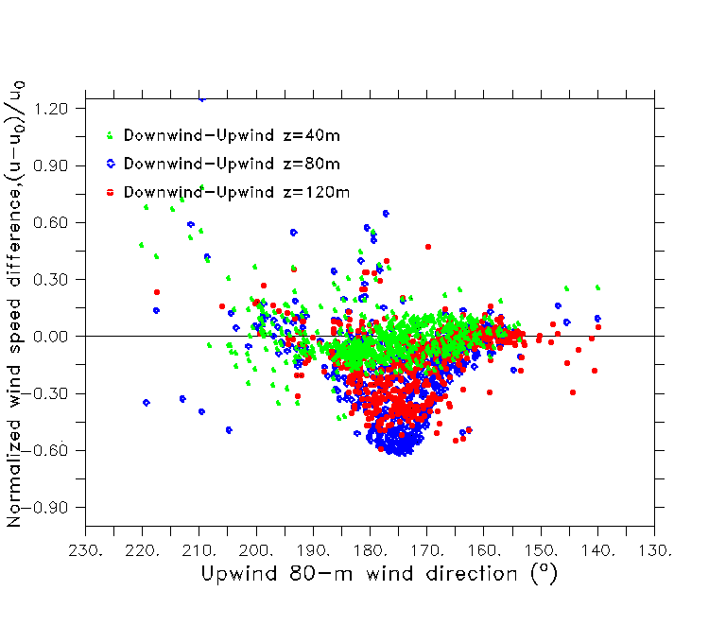
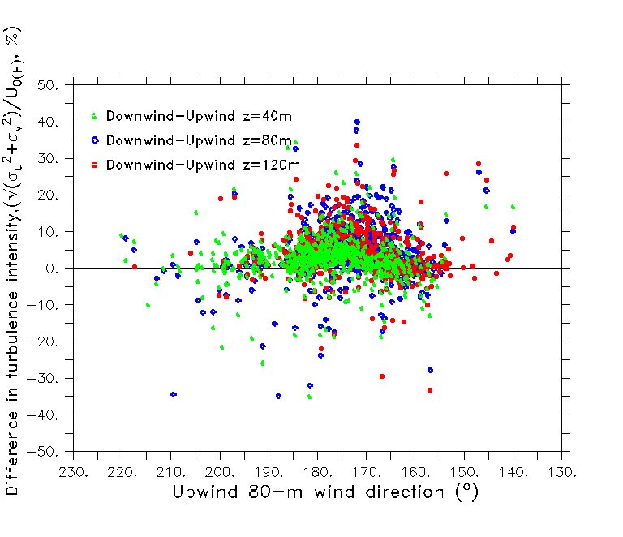
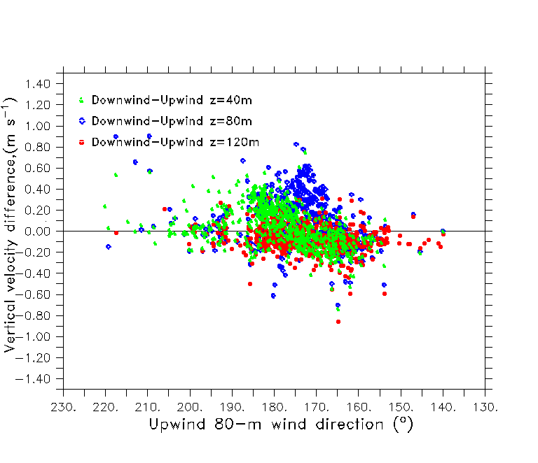
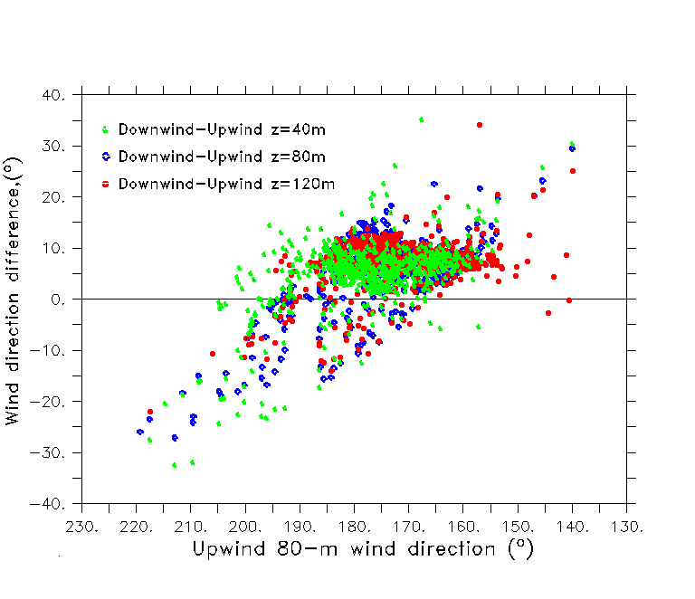
CWEX-11 LiDAR wake summary (°)
Normalized speed (ΔU/U_{0(H)})
Turbulence Intensity (σ_{u}²+σ_{v}²)^{1/2}/U_{0(H)}) (%)
Centerline
impacts
important
for speed,
10-15 °
expansion
of other
variables
LES models suggest largest TI at rotor top, not at hub height?
Vertical velocity (w) (m/s)
Wind direction (°)
Backing wind direction
in wake from hub height
to rotor bottom
Uplift only in center-line of wake?
Uplift only in center-line of wake?

Slide 11
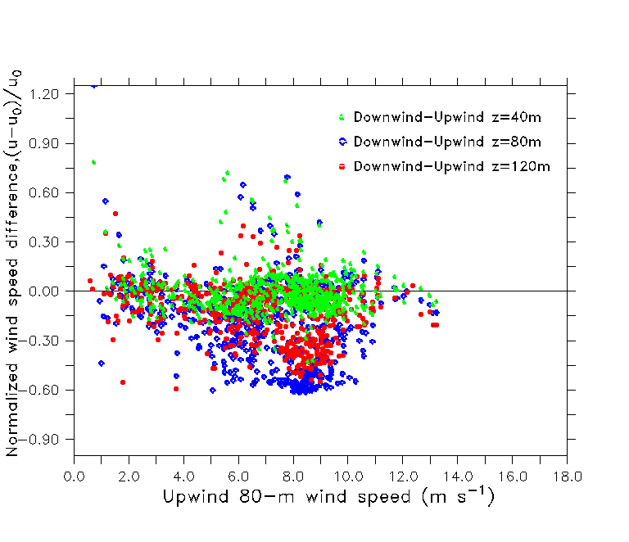
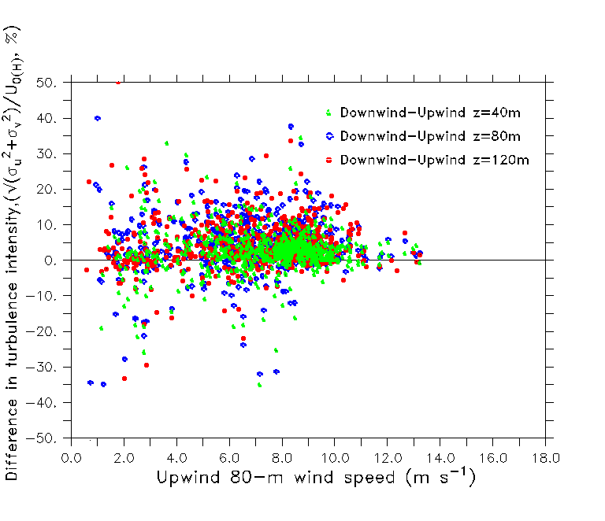
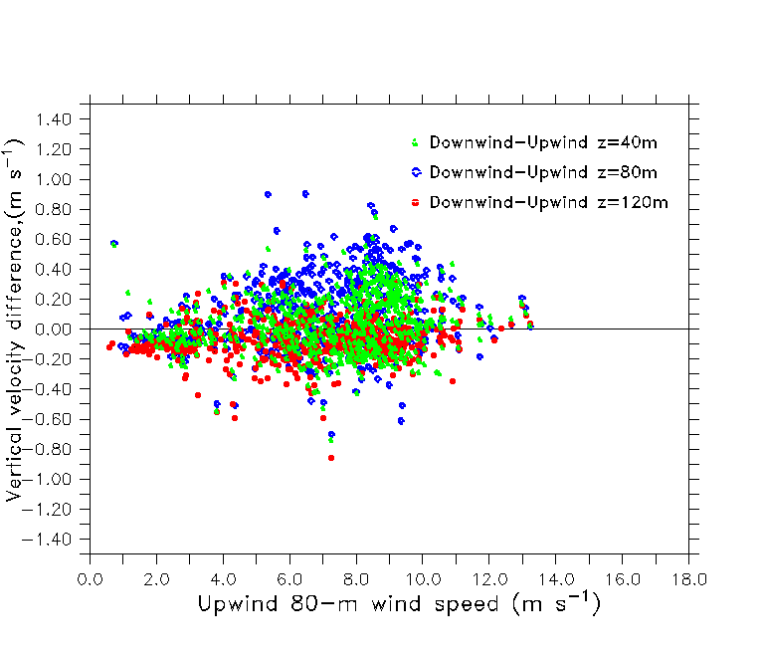
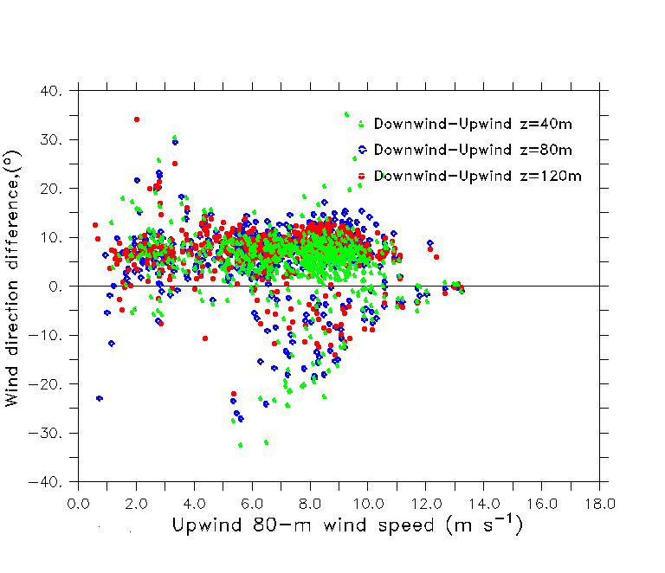
CWEX-11 LiDAR wake summary (U_{0(H)} )
Normalized speed (ΔU/U_{0(H)})
Turbulence Intensity (σ_{u}²+σ_{v}²)^{1/2}/U_{0(H)}), (%)
Normalized speed (ΔU/U_{0(H)})
Largest difference at U_{0(H)}
near 9 m/s
for all variables
Vertical velocity (w) (m/s)
Wind direction (°)
Greatest
uplift for highest speed
deficit [pressure field?]
Decrease in directional
difference for
9 < U_{0(H)} < 13 ms⁻¹

Slide 12
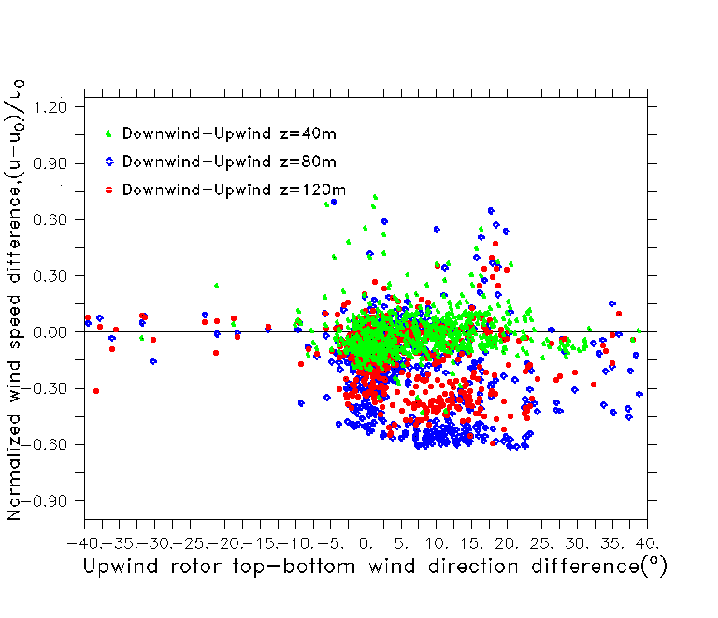
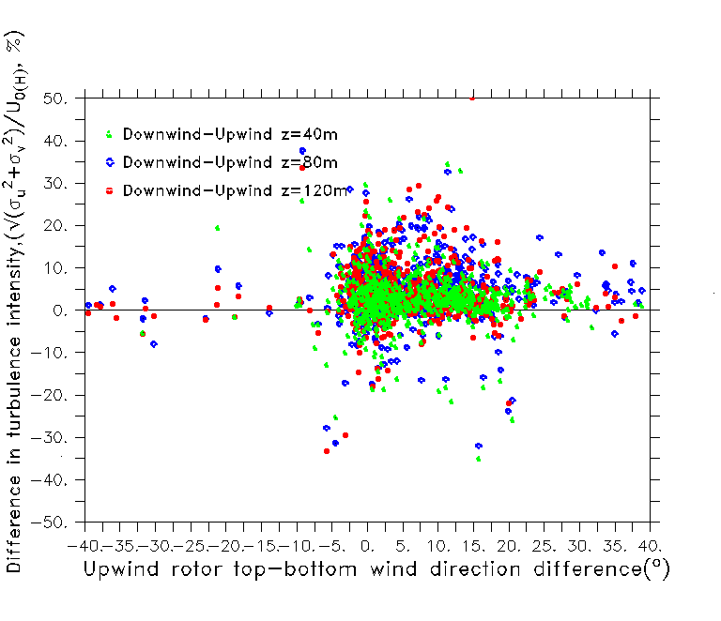
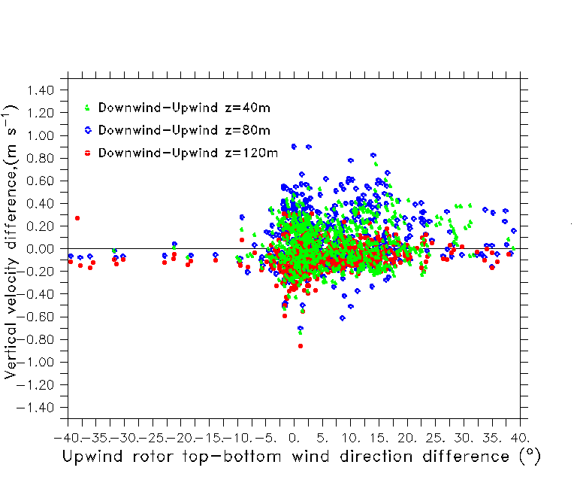
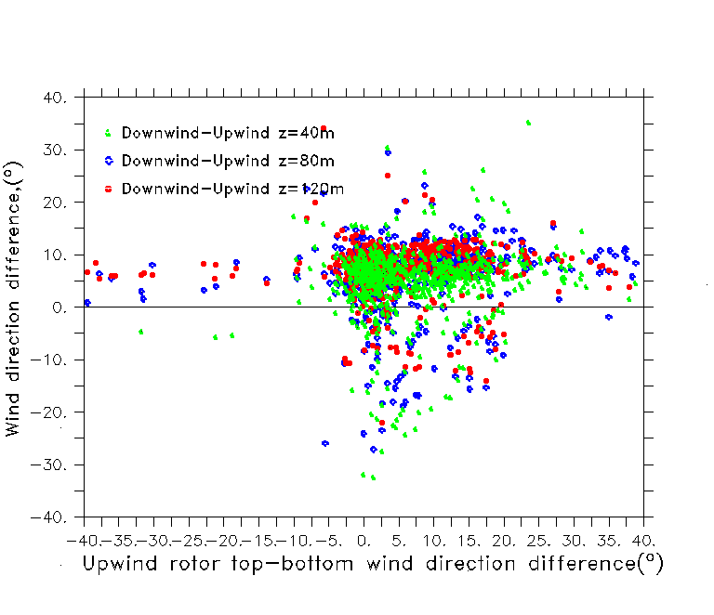
CWEX-11 LiDAR wake summary (°_{TOP}-°_{BOTTOM})
Normalized speed (ΔU/U_{0(H)})
Turbulence Intensity (σ_{u}²+σ_{v}²)^{1/2}/U_{0(H)}) (%)
Vertical directional shear > 20-25 ° reduces wake influence of all variables
These are for
unstable periods
Vertical velocity (w) (m/s)
Wind direction (°)

Slide 13
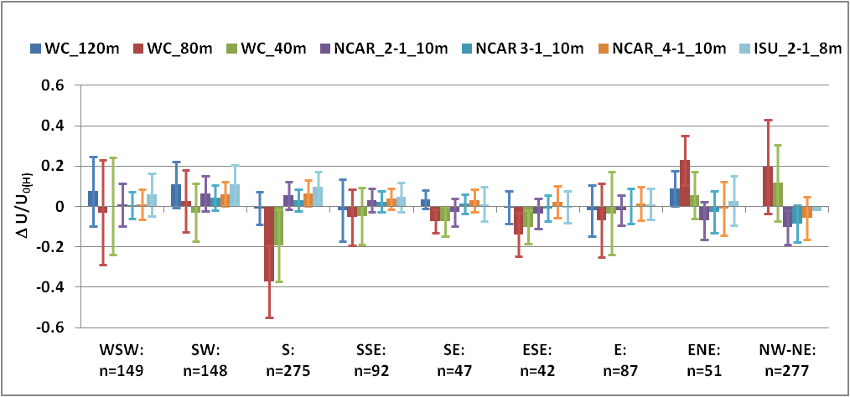
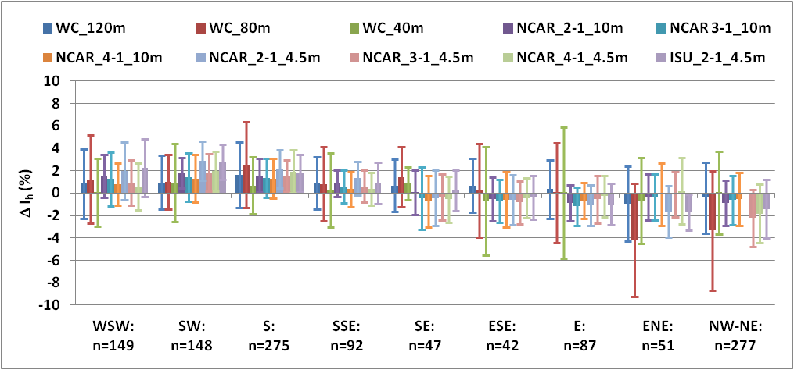
CWEX-11 Wake detection for multiple wind directions (STABLE)
near-wake
characterized
by pressure drag
around the rotor
Normalized speed (ΔU/U_{0(H)})
Velocity deficit increasing
for multiple wakes upstream
Similar TI enhancement as Exps. 4,7,A
(Barthelmie et al.2003) also (2007)
Surface stations report similar increase in TI as within rotor depth
(smaller below rotor-depth change in TI for LES and wind tunnel modeling?)
Δ (σ_{u}²+σ_{v}²)^{1/2}/U_{0(H)}), %
<1% increase for x>6D

Slide 14
Summary
CWEX measurements offer agreement to previously reported studies
Similar rotor-depth intensity and location for ΔU/U_{0(H) ,} σ_{U}/U_{0(H)}
Less impact to flow and scalars at the surface
Peak forcing of turbine-turbulence or the pressure field can be detected from rotor-depth differences (downwind-upwind) of ΔU/U_{0(H) ,} σ_{U}/U_{0(H) ,} w etc.
Classified by reference wind speed/direction/stability
Future statistical analyses will address significance of the differences
Additional profile and surface measurements will facilitate improvement in numerical assessment of wake characterization

Slide 15
References
Barthelmie, R. J., and Coauthors, 2009: Quantifying the impact of wind turbine wakes on power output at offshore wind farms. J. Atmos. Oceanic Technol., 27, 1302–1317.
doi:http://dx.doi.org/10.1175/2010JTECHA1398.1.
Barthelmie R.J. and Coauthors, 2007: Modeling and measuring power losses and turbulence intensity in wind turbine wakes at the Middelgrunden offshore wind farm. Wind. Energ., 10,517-528. doi:10.1002/we.238.
Barthelmie R.J. and Coauthors, 2003: Offshore wind turbine wakes measured by Sodar.
J. Atmos. Oceanic Technol., 20, 466-477.
Christiansen, M.B., and C.B. Hasager, 2005: Wake effects of large offshore wind farms identified from satellite SAR. Remote Sens. Environ., 98, 251-268.
Emeis, S., 2010: Meteorological explanation for wake clouds at Horns Rev wind farm.
Dewi Magazin, 37, 52-55.
Rajewski, D. A. and co-authors, 2012: CWEX: Crop/Wind-energy EXperiment: Observations of surface-layer, boundary-layer and mesoscale interactions with a wind farm, Bull. of the Americ.Meteorol. Soc. (In press).
Wang, H., and E. S. Takle, 1995: A numerical simulation of boundary-layer flows near shelterbelts. Bound.-Layer. Meteorol., 75, 141-173.

